Slide 1
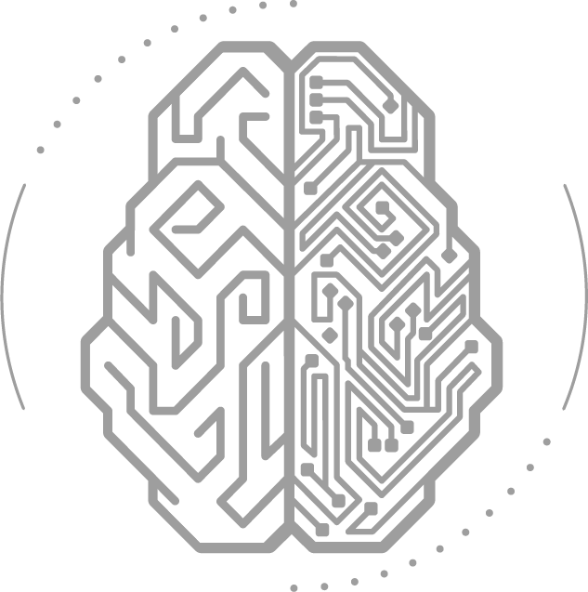
MLOps Pipelines and Architecture

Slide 2
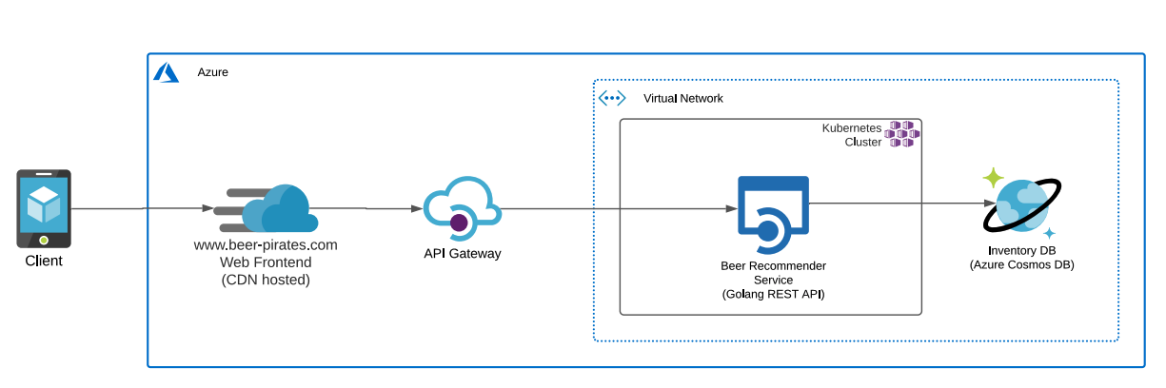
Background
Existing system on Microsoft Azure with microservices in Python and Golang, managed via Kubernetes.
Target microservice: BeerRecommender REST API in Go, fetching recommendations from Inventory DB
Objective: Integrate the ML model into the existing architecture without disrupting current operations.

Slide 3
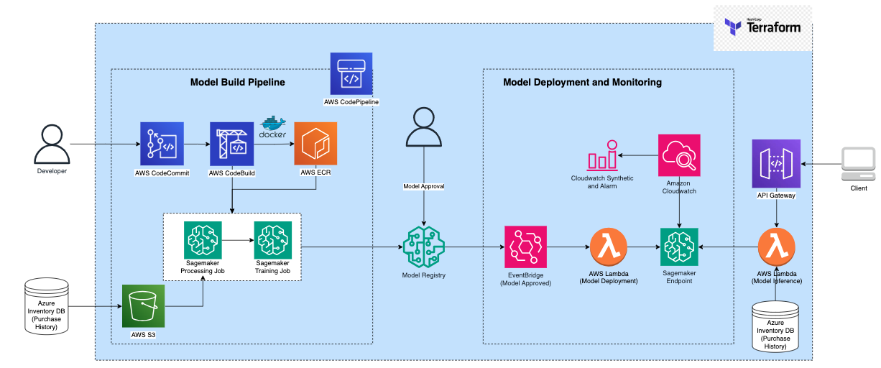
Proposal
www.peer-pirates.com
Web Frontend

Slide 4
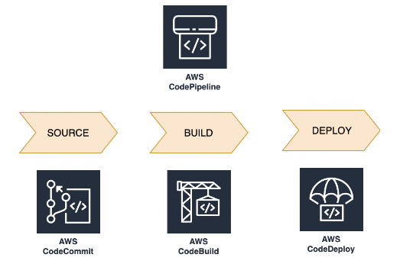
CI/CD and Automation
Utilize CodePipeline, CodeCommit, and CodeBuild for Continuous Integration and Continuous Deployment (CI/CD) automation.
After code is merged/pushed to the main branch, CodeBuild is triggered for operation like unit testing, containerization, submission of new job and deployment.

Slide 5
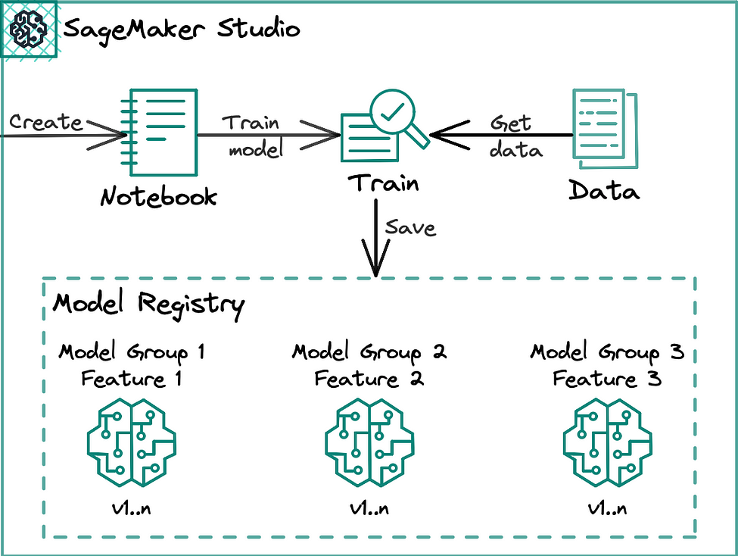
Seamless Training
Automated Model Training: SageMaker training and processing jobs auto-triggered via CodeBuild.
Model Approval Process: Uploaded model requires user approval in the model registry.
Blue/Green Deployment Workflow: SageMaker creates a new fleet (green) alongside the existing one (blue) for updates. Traffic gradually shifts to the new fleet; upon smooth operation during the baking period, SageMaker terminates the old fleet.
Auto-Rollback Mechanism: If issues arise, SageMaker triggers auto-rollback to the previous fleet, ensuring endpoint availability and minimizing production impact.
ECR Image

Slide 6
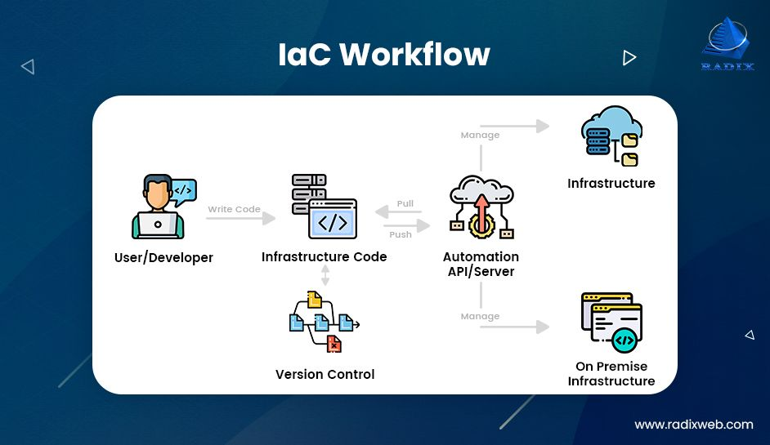
Infra as Code - Terraform
Infrastructure as Code (IaC) enables infrastructure provisioning and management through code, offering repeatability, consistency, and version control.
Terraform supports multiple cloud providers (AWS, Azure, Google Cloud, etc.) and various services within these providers.
Allows for orchestration of the entire infrastructure lifecycle, from creation to modification to decommissioning.
Supports collaboration by enabling teams to work on the same infrastructure codebase.

Slide 7

THANK YOU

